Slide 1

Odd one Out
Team Members:
Sakshitha Channadi
Aishwarya Rajuladevi Manikyam

Slide 2
Objective
Input: You find grid of images and you need to select the picture which is different from others.
Output: If you click on the image which is different from the other images, you win the game! Or else you get to try it again.

Slide 3
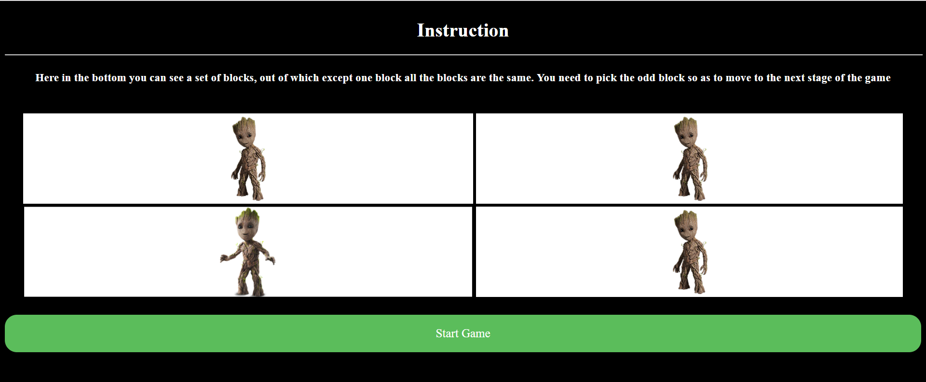
Design

Slide 4
Flow Chart
Home page
Start game
Read Instructions
3 Levels
Test run and start game
User clicks on different image
User Loses!
N
Y
Goes to next level
UserWins!

Slide 5
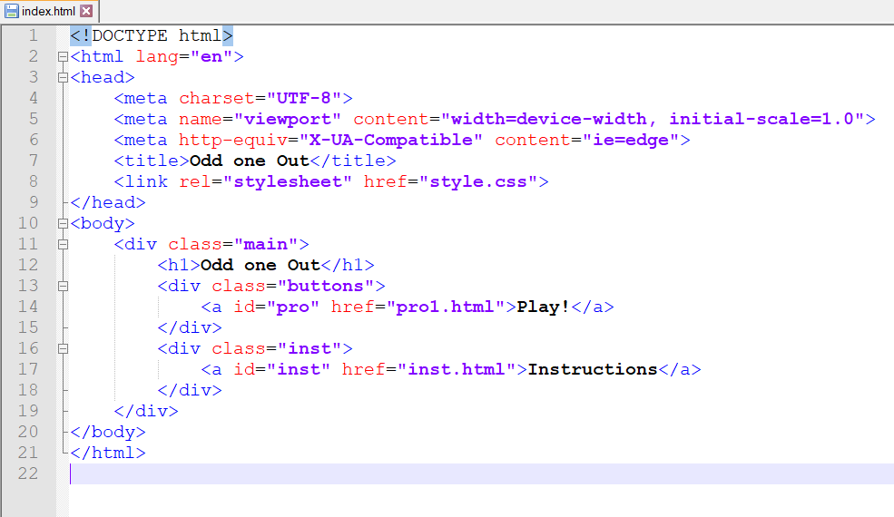
HTML

Slide 6
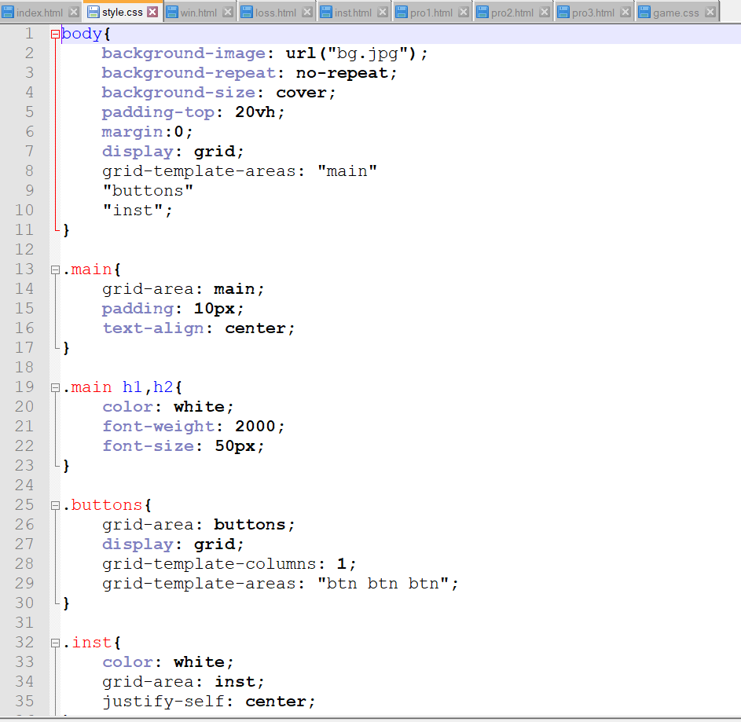
CSS

Slide 7
DEMO

Slide 8
THANK YOU!!

